Slide 1
Status report #8
2019.12.12 (Thu)
B4 T. FUJIWARA
Writing “宇宙論” Mid-term report
Presentation at B4 seminar
Prepare for test beam at ELPH
T1-2, 3 : MPPCやらかしました...
TOF counter 製作開始しました

Slide 2
Prepare for test beam at ELPH
My task: T1, T2 trigger and TOF counter
Direction of beam
TOF Counter
T1
T2
AC
BLT
Akiyama san’s
Water Cerenkov Counter

Slide 3
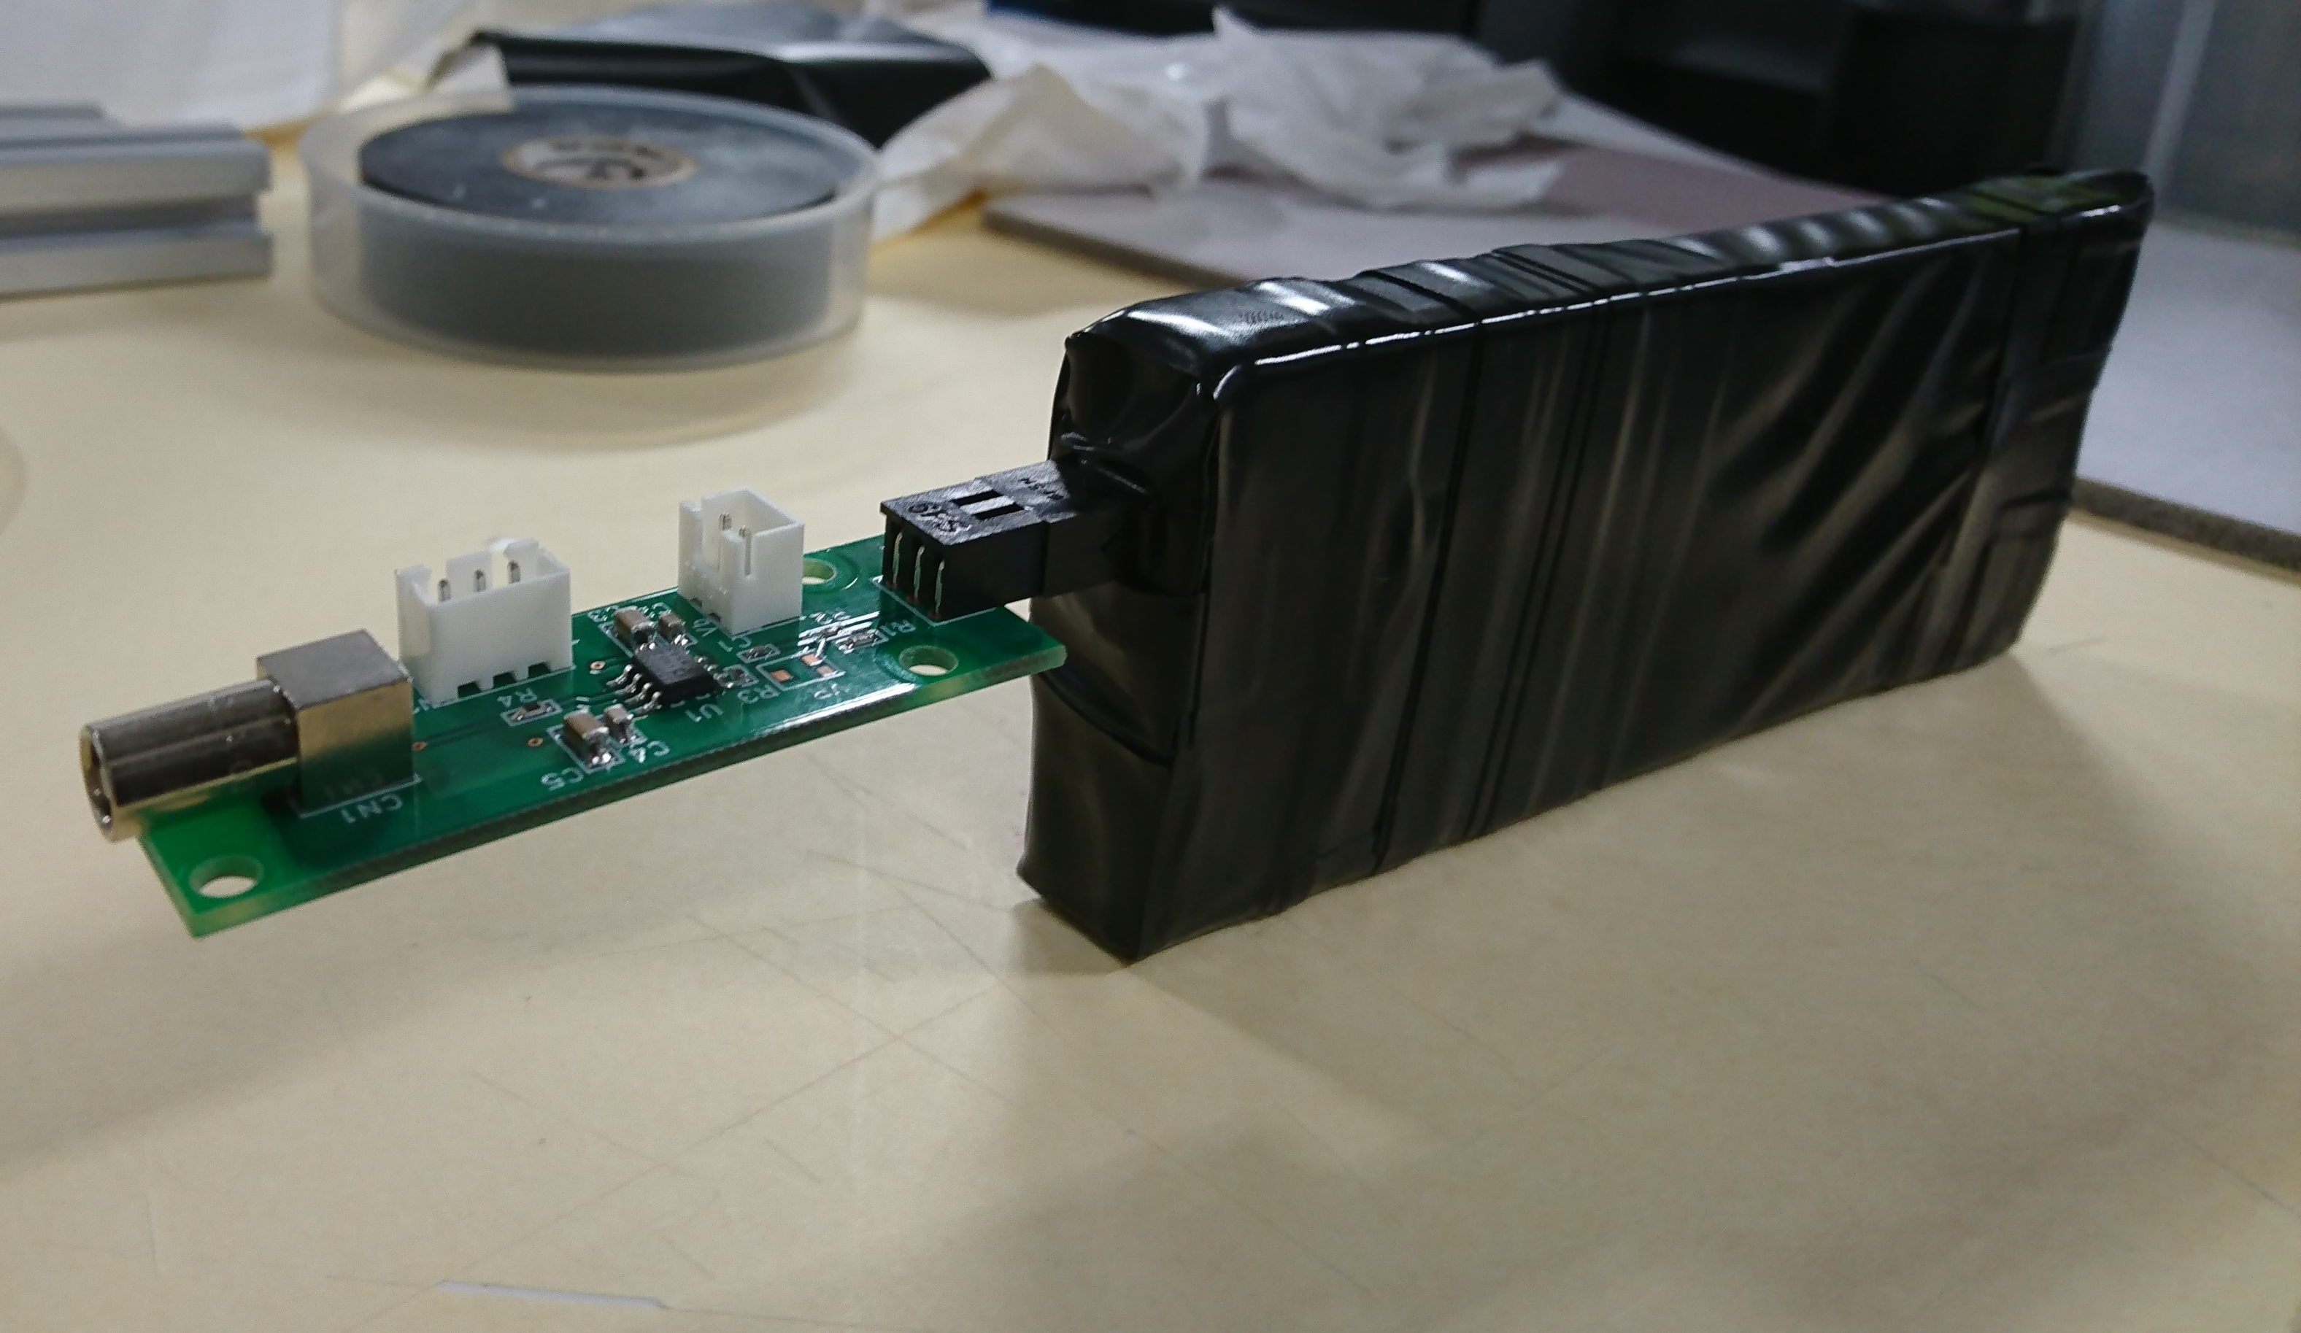
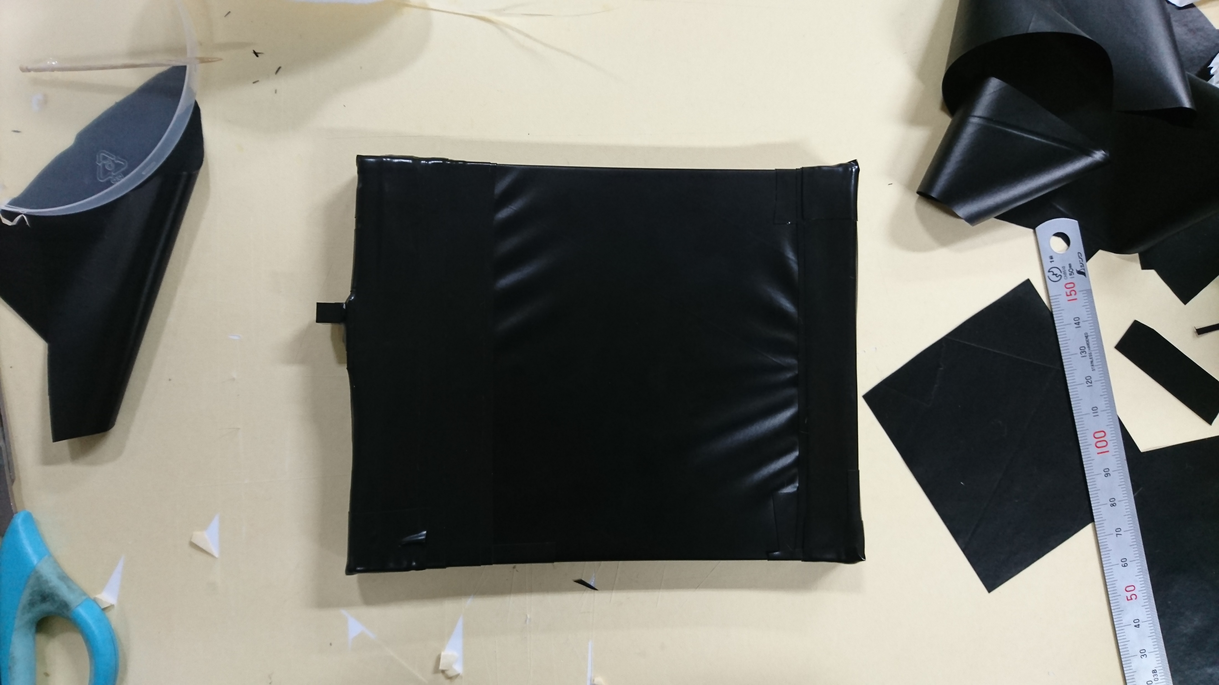
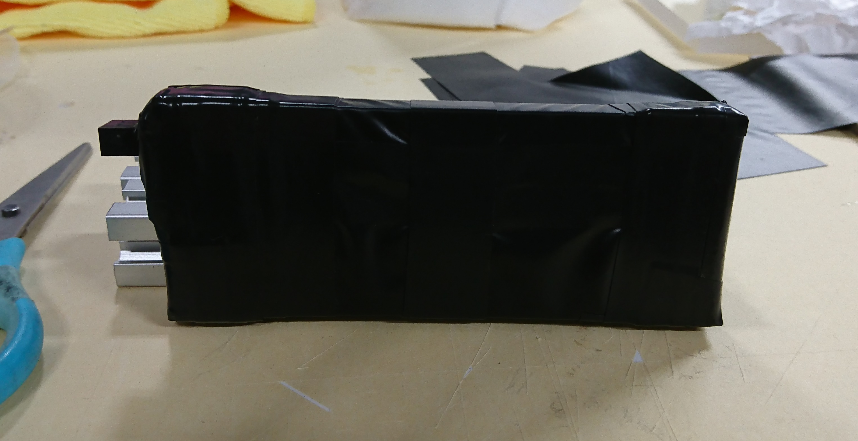
T1-2,3 & T2 Trigger

Slide 4
T1-2,3 & T2 Trigger
Checked 1photon signal again with V_{op} = 58.0V
*) T1-2 ~6mV
*) T1-3 ~5mV
*) T2 ~7mV:
Signal using β-ray source with V_{op} = 58.0V
:*) T1-1 ~200mV
:*) T1-2 ~55mV
:*) T1-3 ~60mV
:*) T2 ~130mV
Set Vth for discriminator
*) T1-1 : -20mV
*) T1-2: -30mV
*) T1-3: -38mV
*) T2 : -40mV
Gathering cosmic ray data,
signal divided for getting QDC, change half value
*) T1-1 : -10mV
*) T1-2: -15mV
*) T1-3: -19mV
*) T2 : -21mV

Slide 5
T1-2,3 & T2 Trigger
Signal using β-ray source with V_{op} = 58.0V
:*) T1-1 ~200mV
:*) T1-2 ~55mV
:*) T1-3 ~60mV
:*) T2 ~130mV
Checked MPPC type used T1-2 & T1-3
T1-1, T2 ⇒ S13360-3050PE
T1-1, T1-3 ⇒ S14160-3015PE
Replace T1-2, T1-3 MPPC ⇒ S13360-3050PE
something wrong?

Slide 6
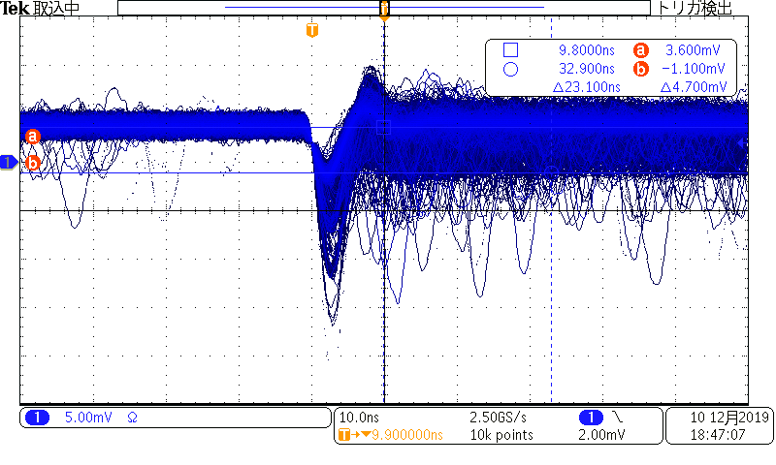
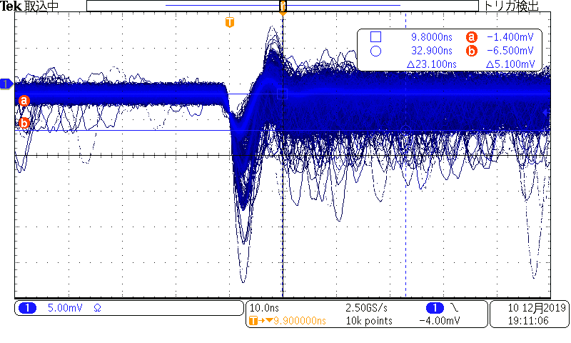
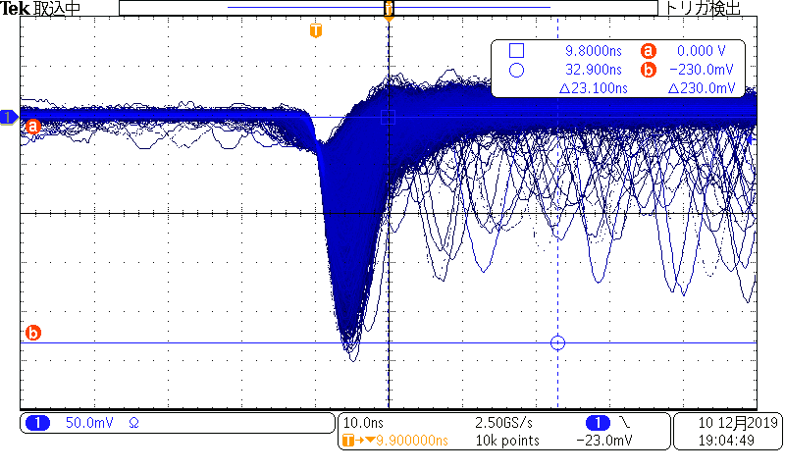
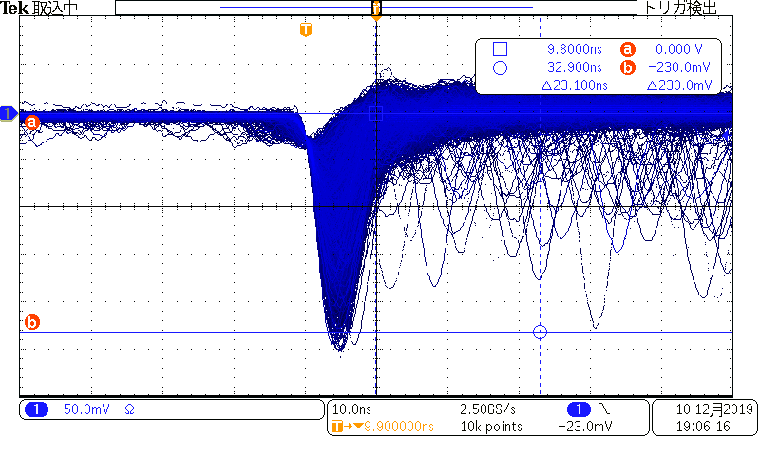
T1-2,3 & T2 Trigger
Replace T1-2, T1-3 MPPC ⇒ S13360-3050PE
T1-2
*) 1photon~ 5mV
*) MIP ~ 230mV
T1-3
*) 1photon~ 5mV
*) MIP ~ 230mV

Slide 7
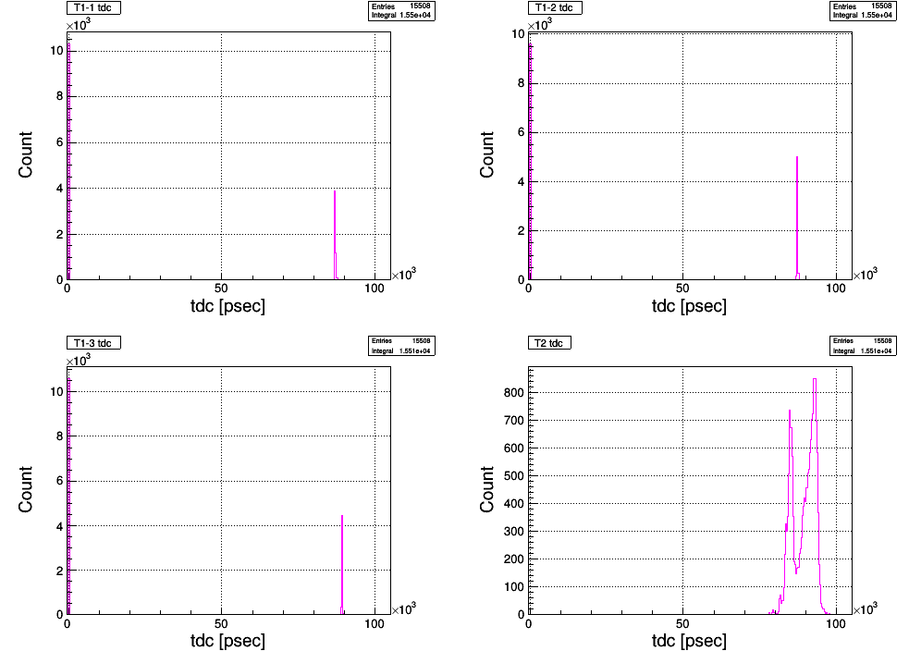
T1-2,3 & T2 Trigger
Set V_{th} for discriminator
*) T1-1 : -10.7mV
*) T1-2: -11.2mV
*) T1-3: -9.7mV
*) T2 : -20.9mV
Gathering cosmic ray data
about 2hours ~7200sec
total events : ~15508
~4900
~5000
~5100
T1-3
T1-2
T1-1
T2
Read out

Slide 8
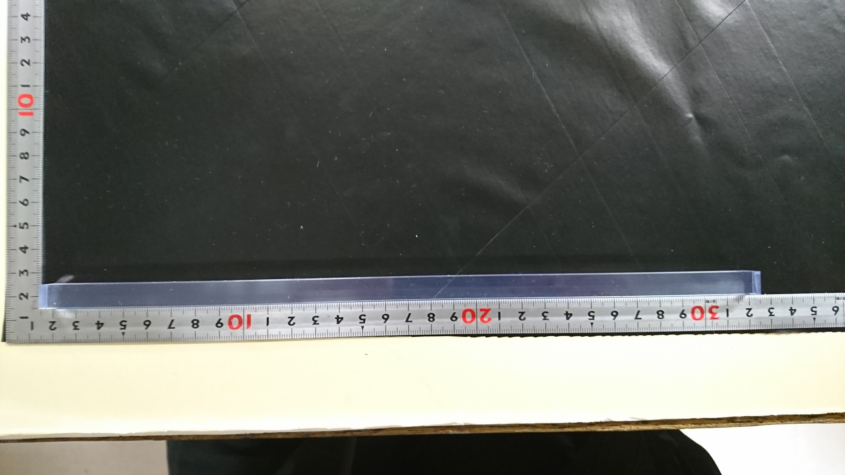
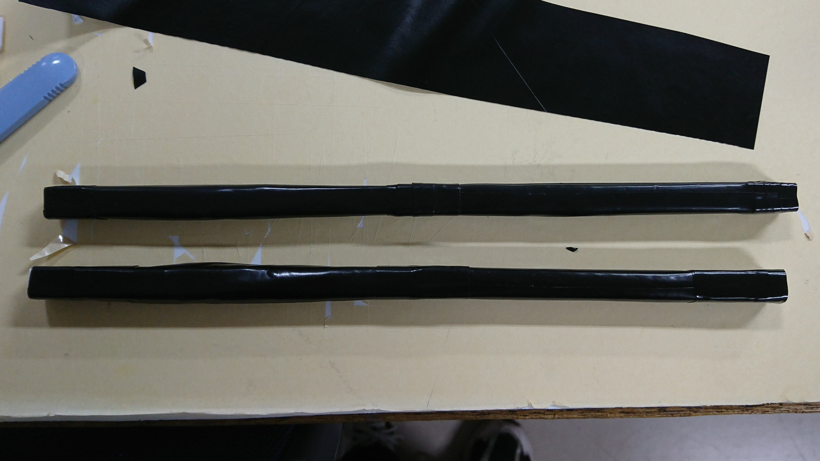
TOF counter
Started making TOF counter
*) How to mounting MPPC
Before : MPPC&circuit
Next : small cross seciotion
⇒ unstable?? (Not to try yet...)
Before
Next
*) 10×10×300 mm scintillator
*) Wrapping Teflon, black vinyl & tape

Slide 9
To do next
TOF counter
total: 8 scintillators ⇒making 6 scintillators
next : mounting MPPC

